Slide 1
Personal Expense Tracker
(Sidhvi Nuvvula, Madhuritha Alle, Usharani Lankalapalli, Chandana Rajashekhar, Saranya Roy, Dhyan Pandya)

Slide 2
Table of Contents:
Problem Definition
Requirements
Database Design
Entity – Relationship Diagram
Implementation
Screenshots of SQL Queries
Application Integration

Slide 3
Problem Definition
Managing personal finances manually is cumbersome and error-prone.
The Expense Tracker project provides a digital solution for tracking expenses, managing budgets, and analyzing spending patterns efficiently.

Slide 4
Requirements
- Functional Requirements:
- User Authentication (Admin/User roles).
- CRUD operations for expenses and budgets.
- Non-Functional Requirements:
- Secure database interactions.
- Responsive user interface.

Slide 5
Database Design
- Entity-Relationship Diagram (ERD):
- Relationships between Users, Expenses, Budgets.
- Normalization:
- Ensures reduced redundancy and data integrity (3NF).
- Schema Overview:
- Users: user_id, email, password, role.
- Expenses: expense_id, user_id, amount, category, date, description.
- Budgets: budget_id, user_id, budget_amount, period, start_date, end_date.

Slide 6
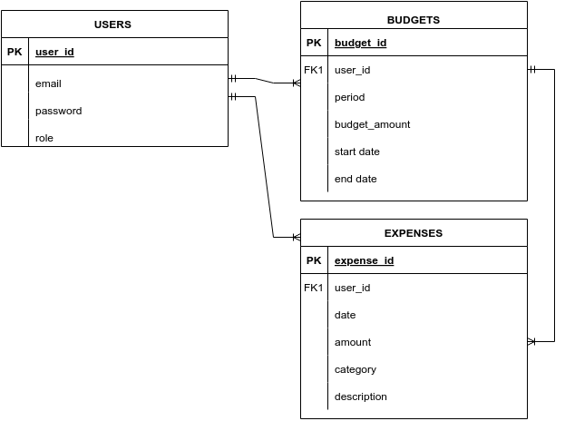
Entity – Relationship Diagram:

Slide 7
Implementation
Users Table:
CREATE TABLE users (
user_id INT AUTO_INCREMENT PRIMARY KEY,
email VARCHAR(255) UNIQUE NOT NULL,
password VARCHAR(255) NOT NULL,
role ENUM('admin', 'user') DEFAULT 'user’ NOT NULL
);
INSERT INTO users (user_id, email,password) VALUES (1, 'Alice Smith', 'alice@example.com'), (2, 'Bob Johnson', 'bob@example.com'), (3, 'Carol Williams', 'carol@example.com'); INSERT INTO users (email, password, role) VALUES ('sidhvinuvvula16@gmail.com', 'Sidhu@1416', 'admin’);
SELECT * FROM USERS;

Slide 8
Expenses Table:
CREATE TABLE expenses ( expense_id INT AUTO_INCREMENT PRIMARY KEY,
user_id INT, amount DECIMAL(10, 2), category VARCHAR(50), date DATE, description VARCHAR(255),
FOREIGN KEY (user_id) REFERENCES users(user_id) ON DELETE CASCADE
);
INSERT INTO expenses (expense_id, user_id, date, amount, category, description) VALUES (1, 1, '2024-10-31', 32.97, 'Entertainment', 'Sample expense data'), (2, 2, '2024-10-24', 121.75, 'Dining Out', 'Sample expense data'), (3, 2, '2024-10-25', 50.67, 'Entertainment', 'Sample expense data'), (4, 1, '2024-11-08', 61.04, 'Utilities', 'Sample expense data'), (5, 3, '2024-11-09', 141.26, 'Dining Out', 'Sample expense data’);
SELECT * FROM expenses

Slide 9
Budgets Table:
CREATE TABLE budgets (
budget_id INT AUTO_INCREMENT PRIMARY KEY,
user_id INT,
budget_amount DECIMAL(10, 2),
period VARCHAR(20), -- 'weekly' or 'monthly'
start_date DATE,
end_date DATE,
FOREIGN KEY (user_id) REFERENCES users(user_id) ON DELETE CASCADE
);
INSERT INTO budgets (budget_id, user_id, budget_amount, period, start_date, end_date) VALUES (1, 1, 794.45, 'weekly', '2024-10-13', '2024-11-12'), (2, 3, 425.87, 'weekly', '2024-10-13', '2024-11-12'), (3, 2, 890.11, 'monthly', '2024-10-13', '2024-11-12'), (4, 3, 339.07, 'monthly', '2024-10-13', '2024-11-12'), (5, 3, 224.22, 'weekly', '2024-10-13','2024-11-12'); SELECT * FROM budgets;

Slide 10
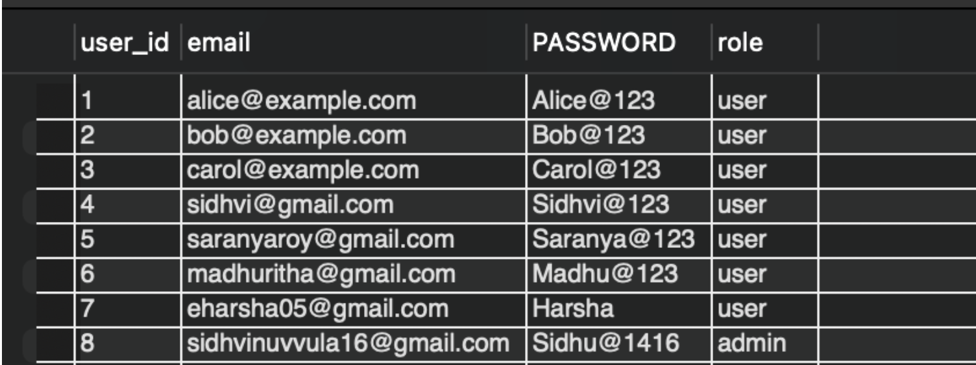
Screenshots of SQL Queries:

Slide 11
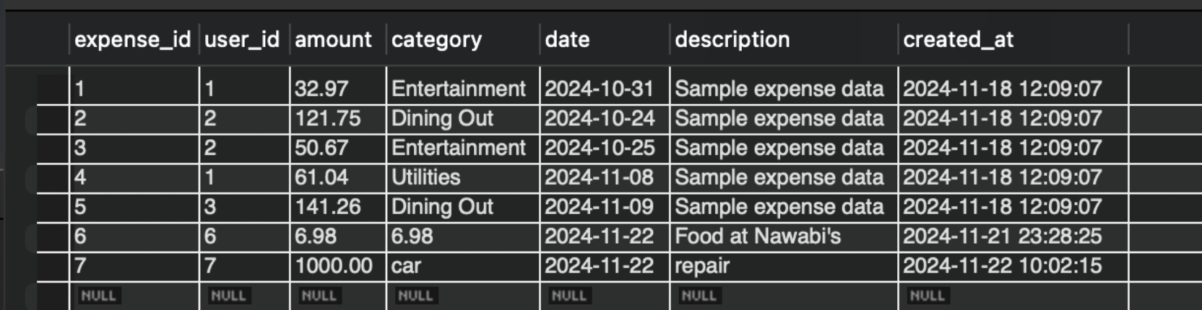

Slide 12
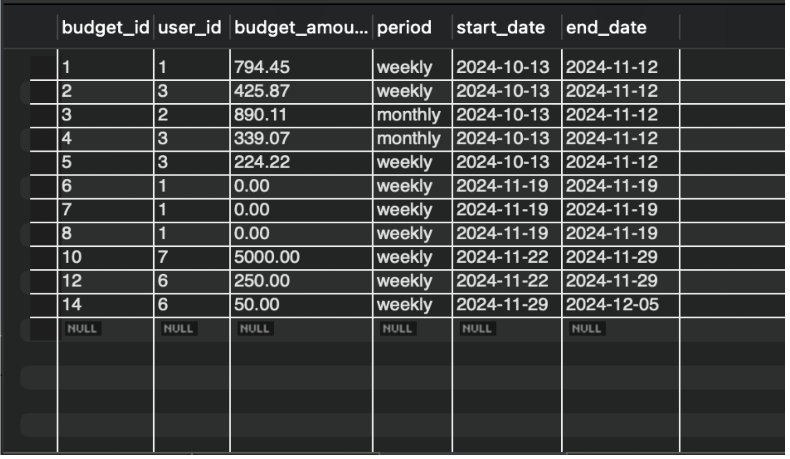

Slide 13
Insights and challenges:
Insights:
Simplified financial management for users.
Role-based secure access ensures data protection.
Challenges:
Integrating Streamlit with MySQL.
Debugging and optimizing CRUD operations.

Slide 14
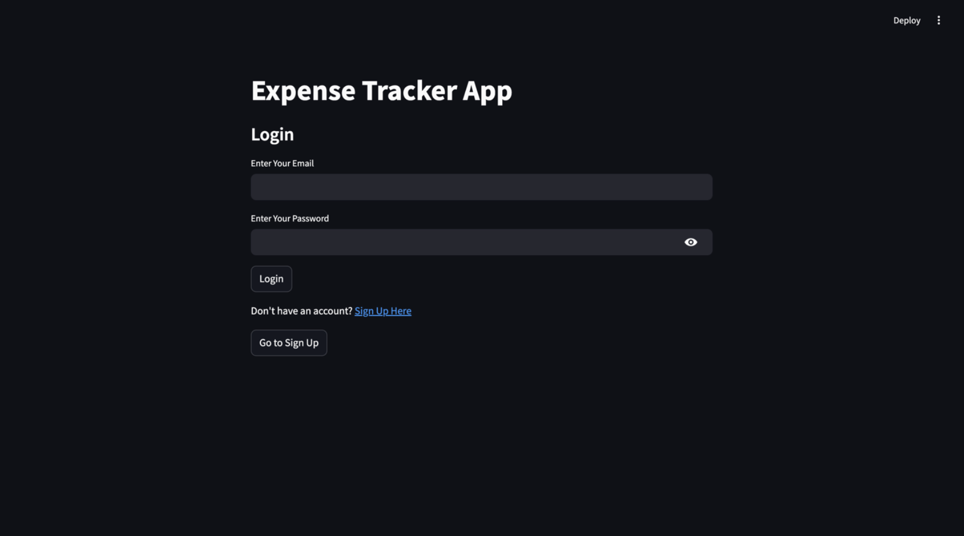
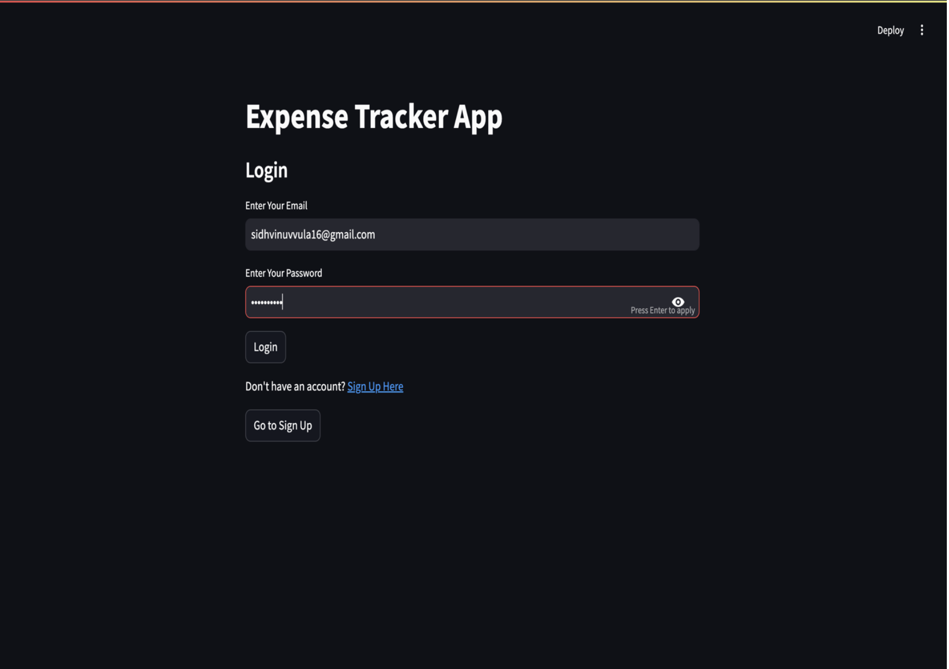
Application Integration:
User Interface:
Tools: Streamlit for the front-end.
Features: Login page, expense management, and budget overview
Screenshots of key UI components:

Slide 15
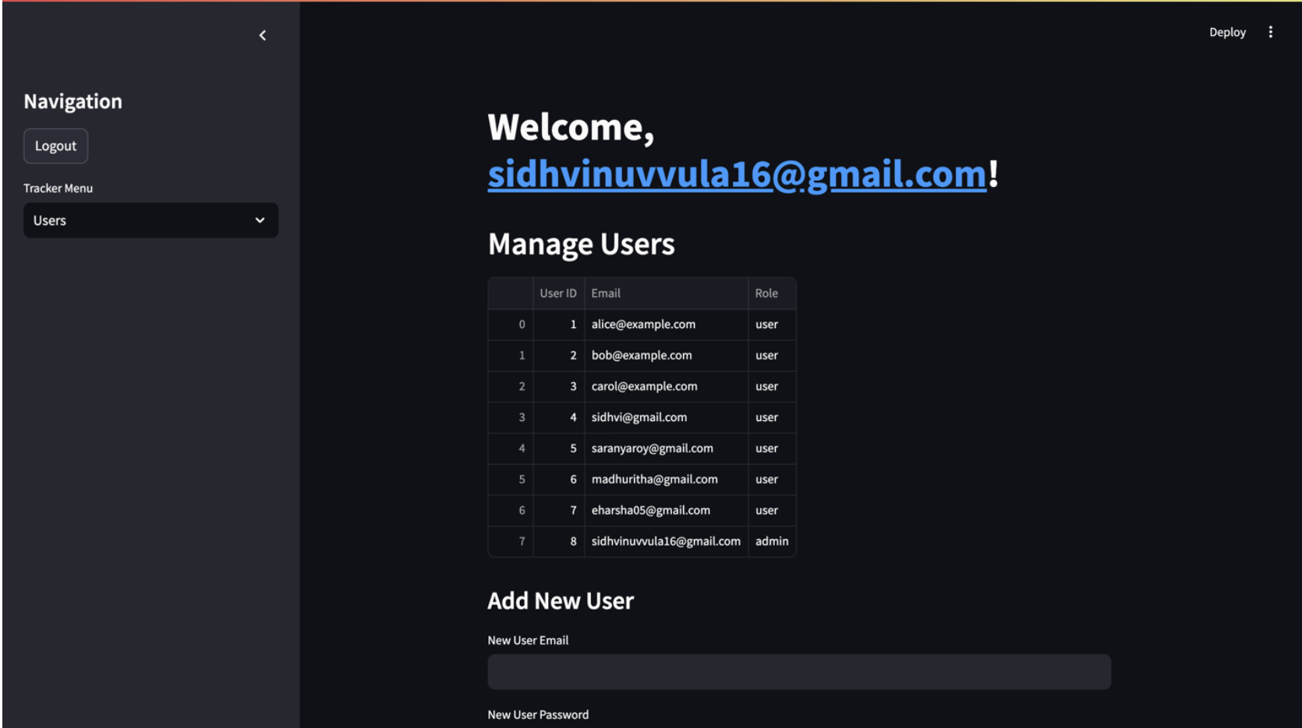
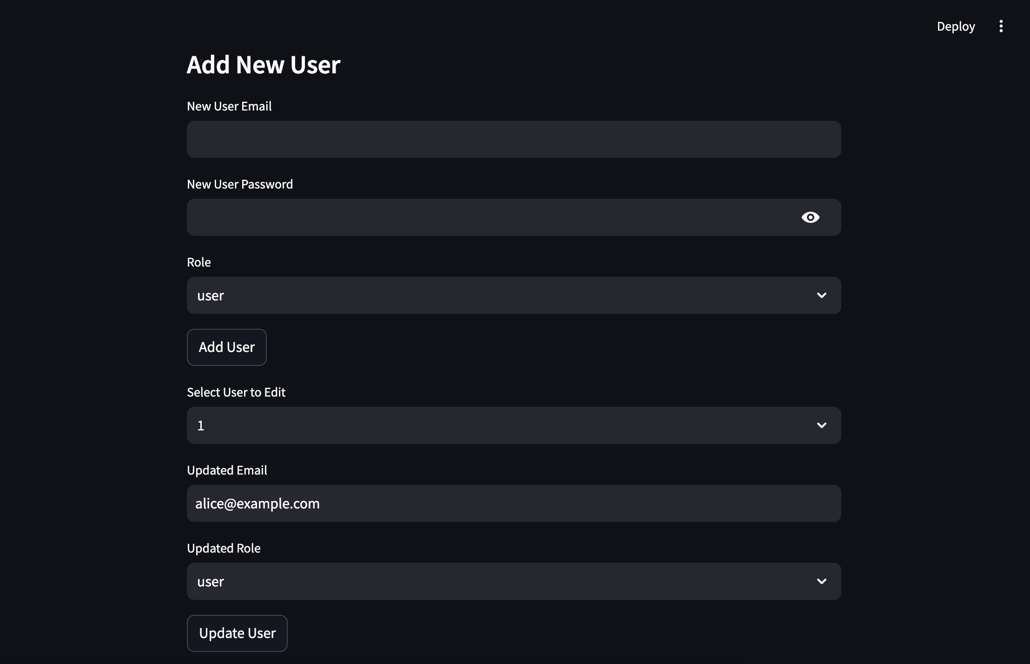

Slide 16
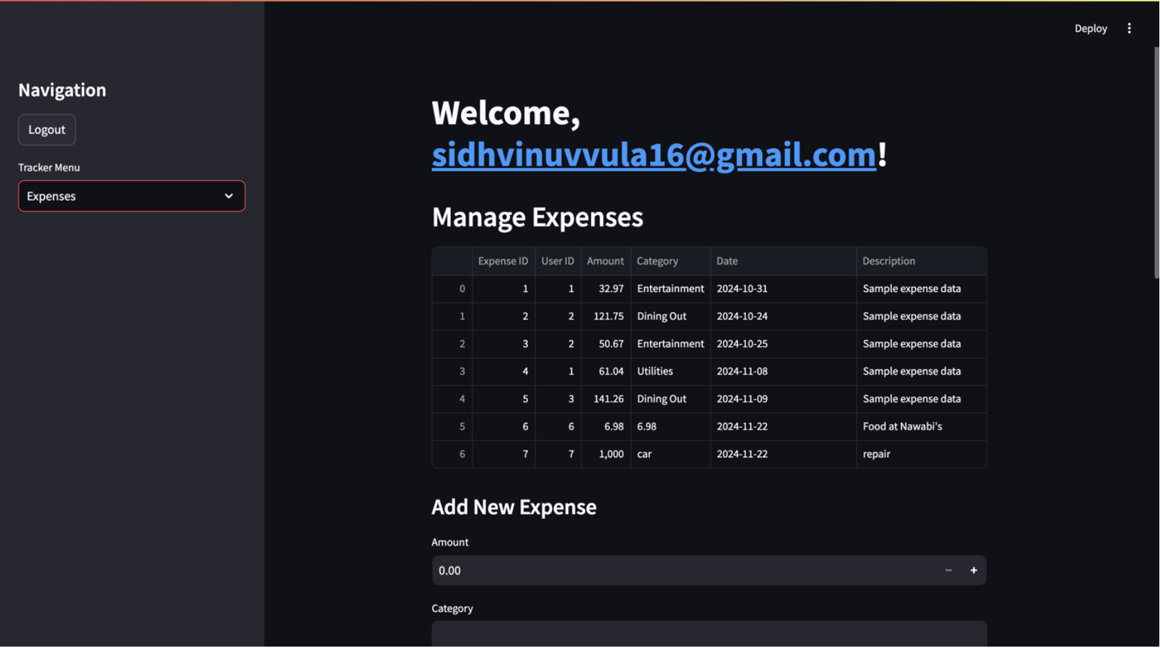

Slide 17
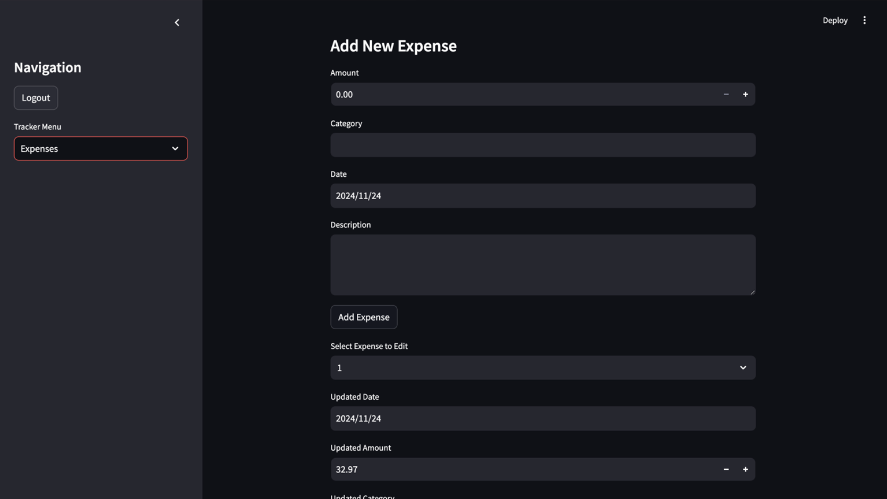
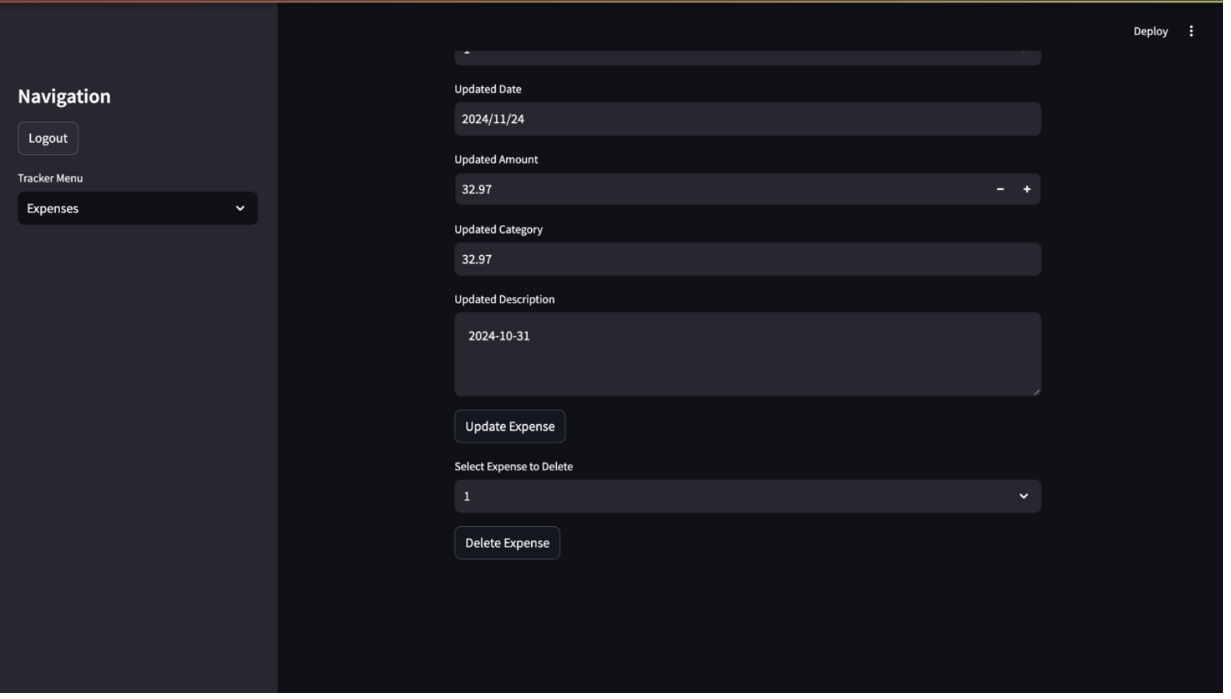

Slide 18
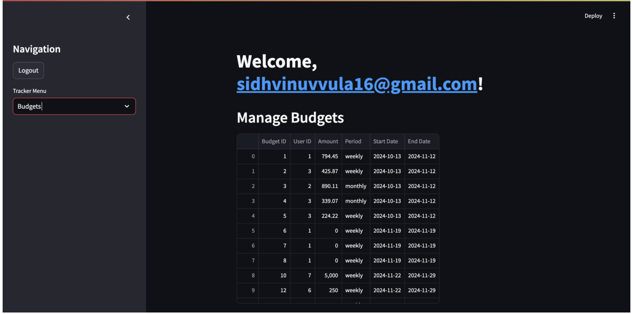

Slide 19
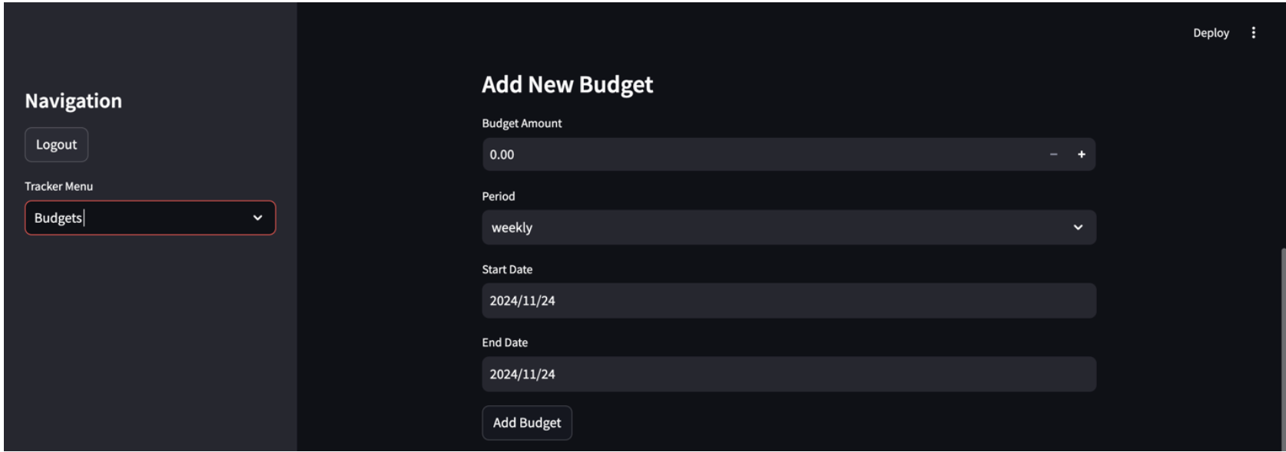
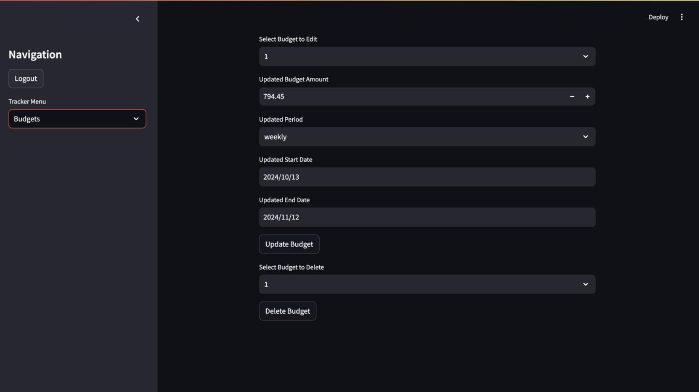

Slide 20
THANK YOU

